Slide 1
Chapter 10 Thinking in Objects

Slide 2
Objectives
To apply class abstraction to develop software (§10.2).
To explore the differences between the procedural paradigm and object-oriented paradigm (§10.3).
To discover the relationships between classes (§10.4).
To design programs using the object-oriented paradigm (§§10.5–10.6).
To create objects for primitive values using the wrapper classes (Byte, Short, Integer, Long, Float, Double, Character, and Boolean) (§10.7).
To simplify programming using automatic conversion between primitive types and wrapper class types (§10.8).
To use the BigInteger and BigDecimal classes for computing very large numbers with arbitrary precisions (§10.9).
To use the String class to process immutable strings (§10.10).
To use the StringBuilder and StringBuffer classes to process mutable strings (§10.11).

Slide 3
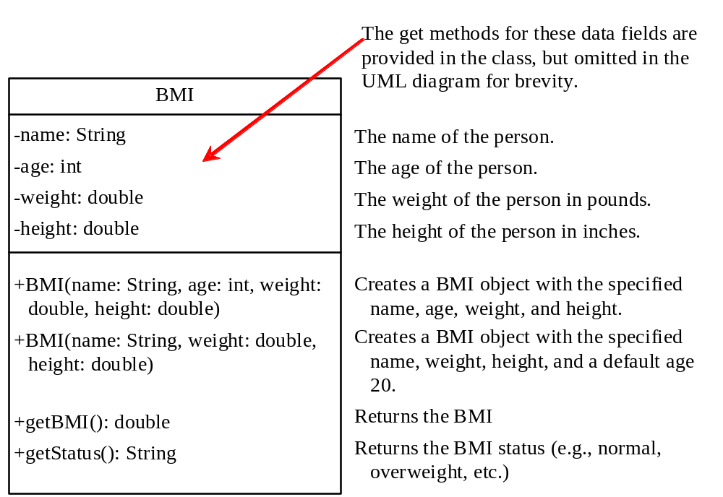
The BMI Class
BMI
UseBMIClass
Run

Slide 4

Class Abstraction and Encapsulation
Class abstraction and encapsulation are two sides of the same coin.
Class abstraction is the separation of class implementation from the use of the class.
The detail of implementation is encapsulated and hidden from the user. This is known as class encapsulation.
The creator of the class provides a description of the class and let the user know how the class can be used.
The user of the class does not need to know how the class is implemented.

Slide 5
Class Relationships
To design classes, you need to explore the relationships among classes.
Common relationships among classes:
Association
Aggregation
Composition
Inheritance

Slide 6
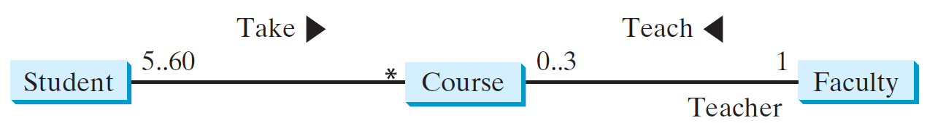
Class Association
Association is a binary relationship that describes an activity between two classes.
For example, a student taking a course is an association between a Student class and a Course class, and a faculty member teaching a course is an association between the Faculty class and the Course class
UML notation below:

Slide 7
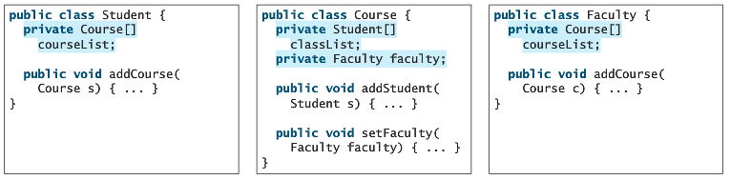
Class Association Contd...
Association relations are implemented using data fields and methods in classes

Slide 8
Class Association Example
Let’s say that we have a Student class and a Course class.
The Student class holds student name and the Course list in which the student is enrolled.
The Course class holds the course name and the Student list enrolled in the course.

Slide 9
Class Association Example
public class Student {
private String name;
private Course[] courseList;
private int numberOfCourses;
//Constructors
Student(String name) {
this.name = name;
courseList = new Course[100];
}
//Get and set methods for all properties
String getName() {
return name;
}
public void setName(String newName) {
name = newName;
}
public int getNumberOfCourses(){
return numberOfCourses;
}
public Course[] getCourseList(){
return courseList;
}
public void addCourse(Course c) {
courseList[numberOfCourses] = c;
numberOfCourses++;
}
}

Slide 10
Class Association Example
public class Course {
private String name;
private Student[] studentList = new Student[30];
private int numberOfStudents;
//Constructor
Course(String n) {
name = n;
}
//Get and set methods
String getName() {
return name;
}
public void setName(String newName) {
name = newName;
}
public int getNumberOfStudents(){
return numberOfStudents;
}
public Student[] getStudentList(){
return studentList;
}
public void addStudent(Student s) {
studentList[numberOfStudents] = s;
numberOfStudents++;
}
}

Slide 11
Class Association Example
public class TestClass {
public static void main(String[] args) {
Course c1 = new Course("Java");
Course c2 = new Course("C++");
Student s1 = new Student("Alanna");
Student s2 = new Student("Tim");
c1.addStudent(s1);
c2.addStudent(s1);
c1.addStudent(s2);
s1.addCourse(c1);
s1.addCourse(c2);
s2.addCourse(c1);
System.out.print("Students enrolled in " + c1.getName() + " are: ");
Student[] s = c1.getStudentList();
for(int i=0; i<c1.getNumberOfStudents(); i++)
System.out.print(s[i].getName() + " ");
System.out.print("\n" + s1.getName() + " is enrolled in: ");
Course[] c = s1.getCourseList();
for(int i=0; i<s1.getNumberOfCourses(); i++)
System.out.print(c[i].getName() + " ");
}
}
Output:
Students enrolled in Java are: Alanna Tim
Alanna is enrolled in: Java C++

Slide 12
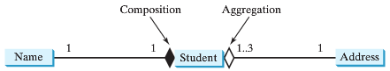
Aggregation and Composition
Aggregation models has-a relationships and represents an ownership relationship between two objects.
The owner object is called an aggregating object and its class an aggregating class.
The subject object is called an aggregated object and its class an aggregated class.
An object can be owned by several other aggregating objects.
If an object is exclusively owned by an aggregating object, the relationship between the object and its aggregating object is know as composition.

Slide 13
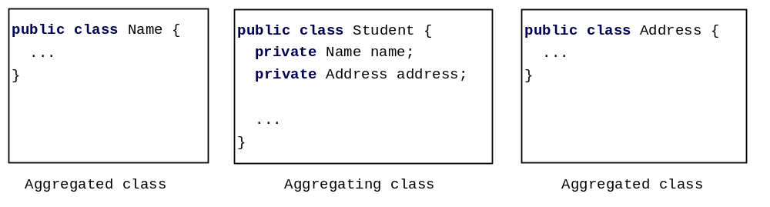
Class Representation
Aggregation and composition relationships are implemented using data fields in classes.

Slide 14

Aggregation Between Same Class
Aggregation may exist between objects of the same class. For example, a person may have a supervisor.
public class Person {
// The type for the data is the class itself
private Person supervisor;
...
}

Slide 15
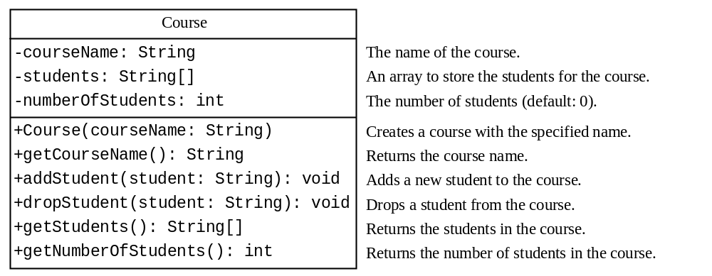
Example: The Course Class
Course
TestCourse
Run

Slide 16
dropStudent Method
/* Remove a student from the course */
public void dropStudent(String student) {
for (int i = 0; i < numberOfStudents; i++) {
if (students[i].equals(student)) {
// Move students[i + 1] to students[i], etc.
for (int k = i + 1; k < numberOfStudents; k++) {
students[k - 1] = students[k];
}
numberOfStudents--;
break;
}
}
}

Slide 17
Clear Method
Add a method named clear() that removes all students from the course.

Slide 18
Clear Method
/** Clear the course */
public void clear() {
for (int i = 0; i < numberOfStudents; i++)
students[i] = null;
numberOfStudents = 0;
}

Slide 19

Example: The StackOfIntegers Class
StackOfIntegers
TestStackOfIntegers
Run

Slide 20
Wrapper Classes
For performance reasons, primitive data type values are not objects in Java.
However, many Java methods require the use of objects as arguments.
Wrapper classes are used to convert a primitive type value into an object.
  int i = 100;
  Integer intObject = new Integer(i);
  int j = intObject.intValue();
Boolean
Character
Short
Byte
Integer
Long
Float
Double
NOTE:
(1) The wrapper classes do not have no-arg constructors.
(2) The instances of all wrapper classes are immutable, i.e., their internal values cannot be changed once the objects are created.

Slide 21
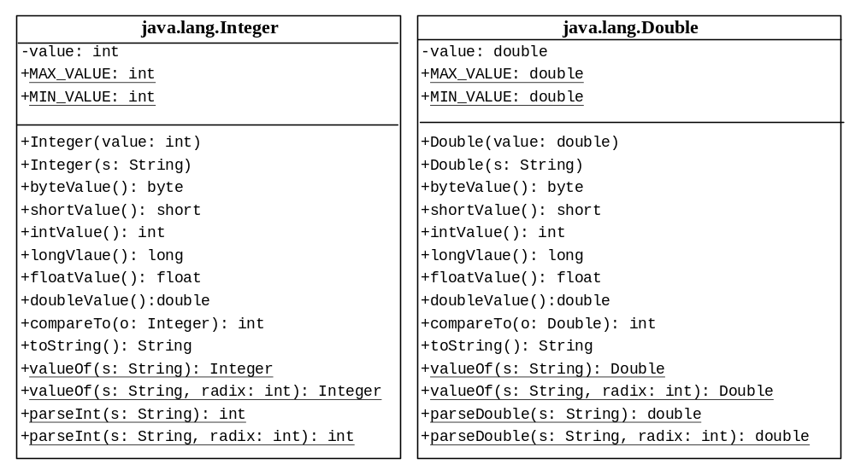
The Integer and Double Classes

Slide 22
Wrapper Class Constructors
You can construct a wrapper class object either from a primitive data type value or from a string representing the numeric value.
  Double d1 = new Double(5.0)
  Double d2 = new Double(“5.0”)

Slide 23
Numeric Wrapper Class Constants
Each numerical wrapper class has the constants MAX_VALUE and MIN_VALUE.
MAX_VALUE represents the maximum value of the corresponding primitive data type and MIN_VALUE represents the minimum values.
System.out.println("The maximum integer is " + Integer.MAX_VALUE);
System.out.println("The minimum positive float is " + Integer.MIN_VALUE);

Slide 24
Conversion Methods
Each numeric wrapper class implements the abstract methods doubleValue, floatValue, intValue, longValue, and shortValue, which are defined in the Number class. These methods convert objects into primitive type values.
Integer intObject = new Integer(5);
int j = intObject.intValue(); //5
double k = intObject.doubleValue(); //5.0

Slide 25
The Static valueOf Methods
valueOf(String s) method creates a new object initialized to the value represented by the specified string. For example:
  Double doubleObject = Double.valueOf("12.4");
  Integer integerObject = Integer.valueOf("12");

Slide 26
The compareTo Method
Returns 1, 0, -1 if this number is greater than, equal to or less than the other number.
For example:
new Double(12.4).compareTo(new Double(12.3)) returns 1;
  new Double(12.3).compareTo(new Double(12.3)) returns 0;
  new Double(12.3).compareTo(new Double(12.51)) returns -1;

Slide 27
The Methods for Parsing Strings into Numbers
Each numeric wrapper class has two overloaded parsing methods to parse a numeric string into an appropriate numeric value.
Integer.parseInt("11") returns 11, 11 is assumed to be in decimal system by default
Integer.parseInt("11", 2) returns 3, 2 indicates that 11 is in binary system and is being converted into a decimal value

Slide 28
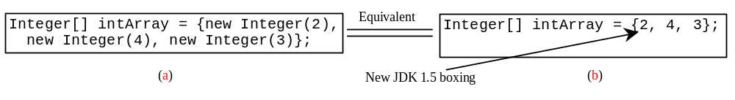
Automatic Conversion Between Primitive Types and Wrapper Class Types
JDK 1.5 allows primitive type and wrapper classes to be converted automatically.
Converting a primitive value to a wrapper object is called boxing.
The reverse conversion is called unboxing.
For example, the following statement in (a) can be simplified as in (b):
System.out.println(intArray[0] + intArray[1] + intArray[2]);
Unboxing

Slide 29
BigInteger and BigDecimal
If you need to compute with very large integers or high precision floating-point values, you can use the BigInteger and BigDecimal classes in the java.math package.
Both are immutable.
Both extend the Number class and implement the Comparable interface.

Slide 30
BigInteger and BigDecimal
BigInteger a = new BigInteger("9223372036854775807");
BigInteger b = new BigInteger("2");
BigInteger c = a.multiply(b); // 9223372036854775807 * 2
System.out.println(c); //18446744073709551614
LargeFactorial
Run
BigDecimal a = new BigDecimal(1.0);
BigDecimal b = new BigDecimal(3);
BigDecimal c = a.divide(b, 5, BigDecimal.ROUND_UP);
System.out.println(c); //0.33334

Slide 31
The String Class
The string class has 13 constructors and more than 40 methods for manipulating strings.
Constructing a String
  String message = new String("Welcome to Java");
  Since strings are used frequently, Java provides a shorthand initializer for creating a string:
  String message = "Welcome to Java";

Slide 32

Strings Are Immutable
animation
A String object is immutable; its contents cannot be changed.
String s = "Java";
s = "HTML";

Slide 33
Interned Strings
Since strings are immutable and are frequently used, to improve efficiency and save memory, the JVM uses a unique instance for string literals with the same character sequence. Such an instance is called interned.

Slide 34
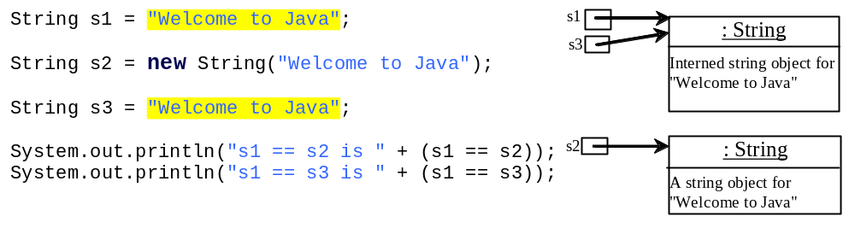
Examples
display
s1 == s2 is false
s1 == s3 is true
A new object is always created irrespective of the value if you use the new operator.
If you use the string initializer, no new object is created if the interned object is already created.

Slide 35
Convert Character and Numbers to Strings – valueOf methods
The String class provides several static valueOf methods for converting a character, an array of characters, and numeric values to strings.
These methods have the same name valueOf with different argument types char, char[], double, long, int, and float.
For example, to convert a double value to a string, use String s = String.valueOf(5.44);

Slide 36
Regular Expressions
A regular expression (abbreviated regex) is a string that describes a pattern for matching a set of strings.
Regular expression is a powerful tool for string manipulations.
You can use regular expressions for matching, replacing, and splitting strings.
Examples include validating emails and phone numbers.

Slide 37
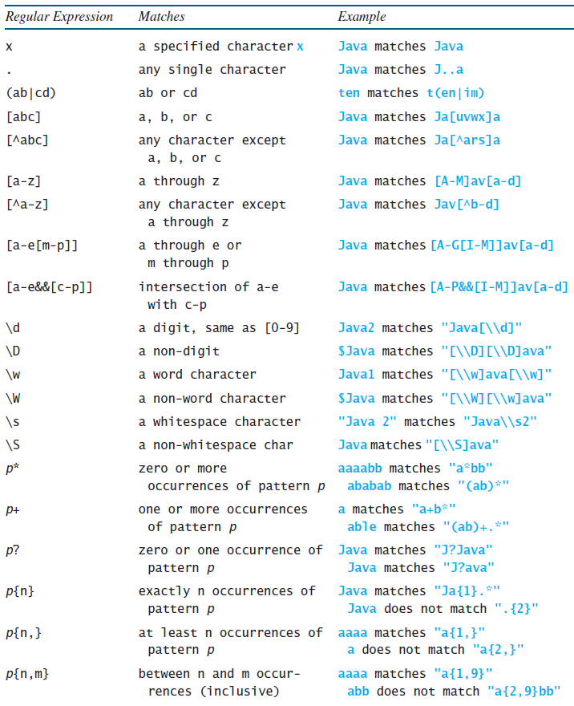
Regular Expression Syntax
System.out.println("Java".matches("Java"));
System.out.println("Java".matches("J..a"));
System.out.println("ten".matches("t(en|im)"));

Slide 38
Example – Verify Format of a Phone Number
For a phone number in format: XXX-XXX-XXXX
System.out.println("973-596-2867".matches("\\d{3}-\\d{3}-\\d{4}"));
OR
System.out.println("973-596-2867".matches("(\\d\\d\\d-){2}\\d{4}"));
For a phone number in format: (XXX)XXX-XXXX

Slide 39
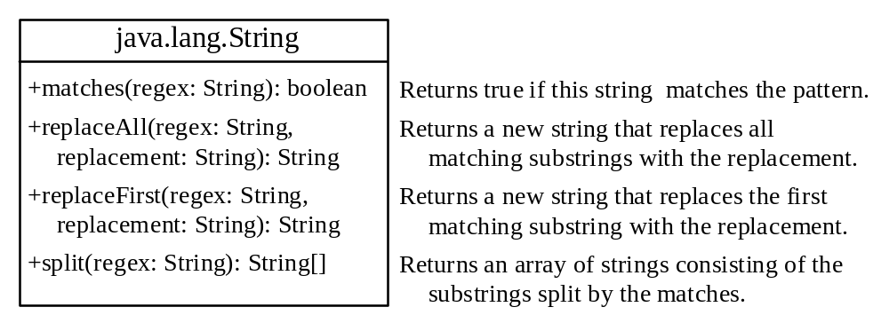
Matching, Replacing and Splitting Strings

Slide 40
Examples
String s = "Java Java Java".replaceAll("v\\w", "wi") ;
//returns Jawi Jawi Jawi
String s = "Java Java Java".replaceFirst("v\\w", "wi") ;
//returns Jawi Java Java
String[] s = "Java1HTML2Perl".split("\\d");
String array s will now hold “Java”, “HTML” and “Perl”
"Java".equals("Java");
"Java is cool".matches("Java.*");

Slide 41
Splitting by Patterns Example
The following statement splits the string into an array of strings delimited by some punctuation marks.
String[] tokens = "Java,C?C#,C++".split("[.,:;?]");
for (int i = 0; i < tokens.length; i++)
System.out.println(tokens[i]);

Slide 42
Matching by Patterns
Ask the user to enter their email.
Now validate the email to make sure that:
1. The email is in the format: <username>@<server_name>.<top_level_domain>
i.e., the email has some text followed by ‘@’ followed by some text, followed by ‘.’ followed by some text again.
2. The username needs to be between 5 and 10 characters and could be numbers or alphabets.
3. The server name can be either “manhattan” or “mancol”.
4. The top level domain can only be “edu”.

Slide 43
StringBuilder and StringBuffer
The StringBuilder/StringBuffer class are similar to the String class except that the String class is immutable.
StringBuilder/StringBuffer is more flexible than String. You can add, insert, or append new contents into a string buffer, whereas the value of a String object is fixed once the string is created.
The String Builder class is similar to StringBuffer class except that each method in StringBuffer is synchronized that is StringBuffer is thread safe, which means that a method can be accessed by only one thread at a time (useful in concurrent programming).
If a string does not require any change, use string class rather than StringBuilder as Java can perform some optimizations with String.

Slide 44
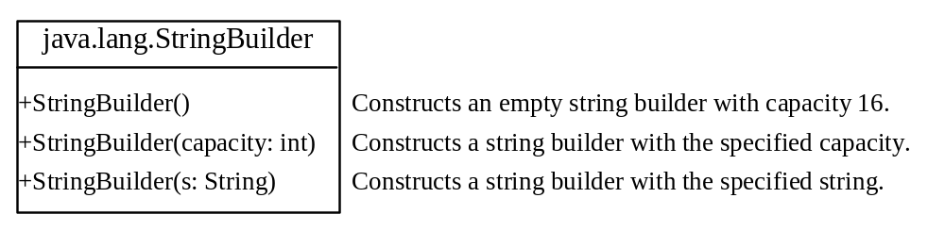
StringBuilder Constructors

Slide 45

Modifying Strings in the Builder

Slide 46

The toString, capacity, length, setLength, and charAt Methods

Slide 47
Examples
StringBuilder stringBuilder = new StringBuilder();
stringBuilder.append("Welcome");
stringBuilder.append(' ');
stringBuilder.append("to");
stringBuilder.append(' ');
stringBuilder.append("Java");
System.out.print(stringBuilder); //“Welcome to Java”

Slide 48
Examples
Suppose, stringBuilder contains “Welcome to Java” before each of the following methods is applied:
stringBuilder.insert(11, "HTML and ") changes the builder to Welcome to HTML and Java
stringBuilder.delete(8, 11) changes the builder to Welcome Java.
stringBuilder.deleteCharAt(8) changes the builder to Welcome o Java.
stringBuilder.reverse() changes the builder to avaJ ot emocleW.
stringBuilder.replace(11, 15, "HTML") changes the builder to Welcome to HTML.
stringBuilder.setCharAt(0, 'w') sets the builder to welcome to Java.

Slide 49
Examples
StringBuilder s = new StringBuilder();
System.out.println(s.capacity()); //16
s.append("apple");
System.out.println(s.length()); //5
System.out.println(s.capacity()); //16
s.trimToSize();
System.out.println(s.capacity()); //5
StringBuilder s2 = new StringBuilder("apple");
System.out.println(s2.capacity()); //21 since capacity is length+16 when you iniialize StringBuilder with a value
s2.setLength(3);
System.out.println(s2); //app

Slide 50
Examples
StringBuilder s = new StringBuilder();
System.out.println(s.capacity()); //16
s.append("Manhattan College");
System.out.println(s.length()); //17
System.out.println(s.capacity()); //34 ((prevCapacity + 1)*2)

Slide 51
Problem: Checking Palindromes Ignoring Non-alphanumeric Characters
Write a program that ignores nonalphanumeric characters in checking whether a string is a palindrome.
PalindromeIgnoreNonAlphanumeric
Run

